Slide 1

Project Proposal
Poro Party
From Poro Pack
Notes:
James

Slide 2
ABOUT US
Poro Pack
Ryan Lin
Raymond Ye
Yoyo Wang
James Park
Mitik Merchant
William Hao
Notes:
James

Slide 3
PRESENTATION ROADMAP
01.
02.
2a.
Elevator Pitch
Market Demand
Target Users
Customer Benefit
03.
04.
Paper Prototype Game Structure
Key Features
Sustainability
Tools & Risks
Notes:
1-2 . 4 minutes
2-2a.4 minutes
3. 7 min
4. 5 min

Slide 4
PROJECT PURPOSE
(ELEVATOR PITCH)
Video Games
Interactive
Multi
player
Socialize
As a group of students who enjoy video games, we want to create an interactive and accessible multiplayer video game so that anyone can socialize and have fun online.
Notes:
James

Slide 5
PROJECT OVERVIEW
CENTRAL LOBBY
Mini Games
4 Players
1v1v1v1
2v2
Cooperative
Competitive
Notes:
James

Slide 6

MARKET DEMAND
Games are always a necessity
Great way for people to grow closer to one another/bond
Notes:
James

Slide 7

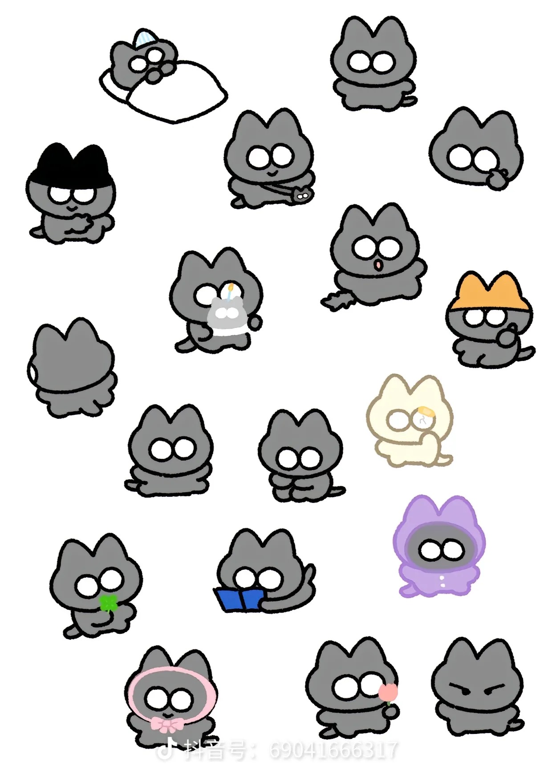
TARGET USERS
AGE RANGE
INTERESTS
10-20
60%
Puzzle
60%
20-30
30%
Racing
80%
30+
10%
Competitive
80%
LOCATION
Principle
Earth
It is designed to be accessible and enjoyable for a wide range of age groups to interact and socialize without any age barriers.

Slide 8
Customer Benefit
Reaction Time
Enhance
Mood & socialize
Fast pace game play requires fast reaction time, which helps the development of brain
At its core, a game provides entertainment, can serve as a natural mood booster
F2P
Healthy Competition
Low barrier of entry, accessible to young age users (main target group)
Develops the sense of competition, teaching perseverance and determination

Slide 9

KEY FEATURES
&
PAPER PROTOTYPE

Slide 10
GAME OVERVIEW
CENTRAL LOBBY
1.JUMP KING
2.BLIND MAZE
4.REVERSE TAG
3.AUDIO OBSTACLES
5.VOLLEYBALL

Slide 11

KEY FEATURES
5 MINI GAMES
MULTIPLE MINI GAME MODES
CENTRAL LOBBY
CUTE CAT CHARACTERS
CHARACTERS BOUNCE
2v2 and 1v1 PVP
with point system
Many variations and game maps
Track overall progress and take the crown!
Cats r cute.
Characters bounce when they touch in all mini-games.

Slide 12
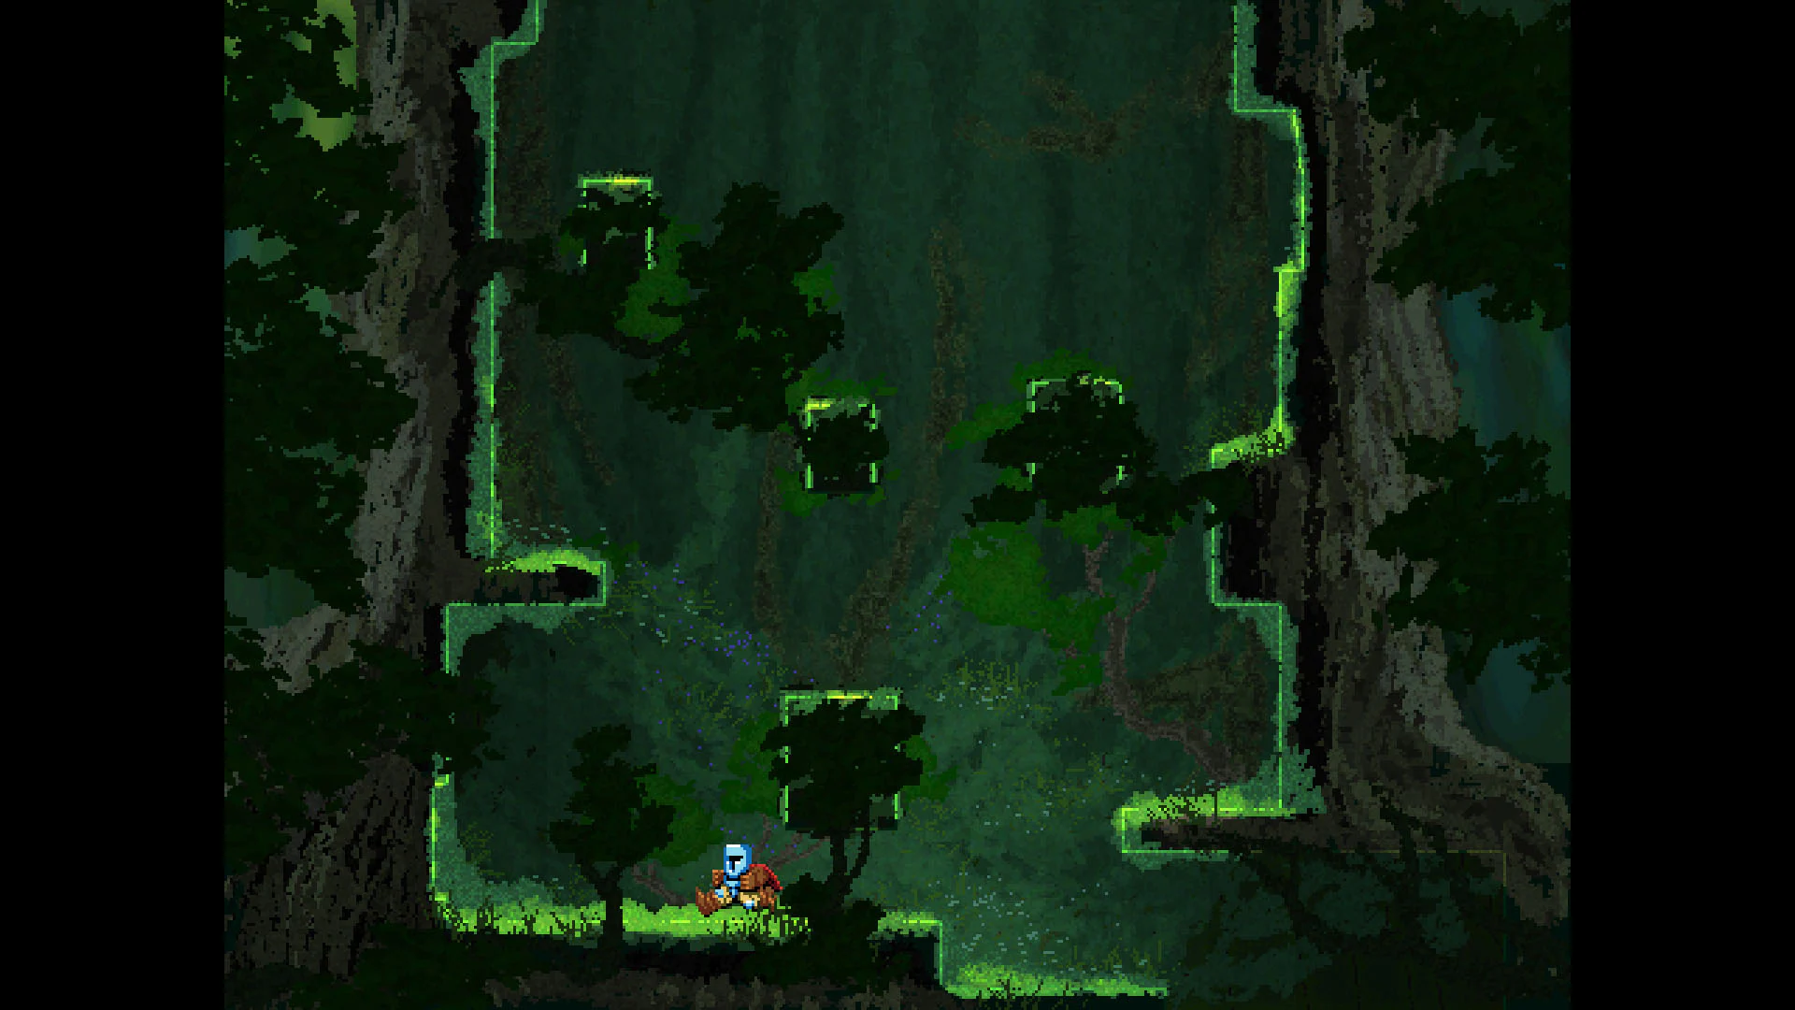
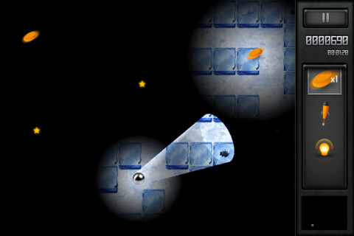
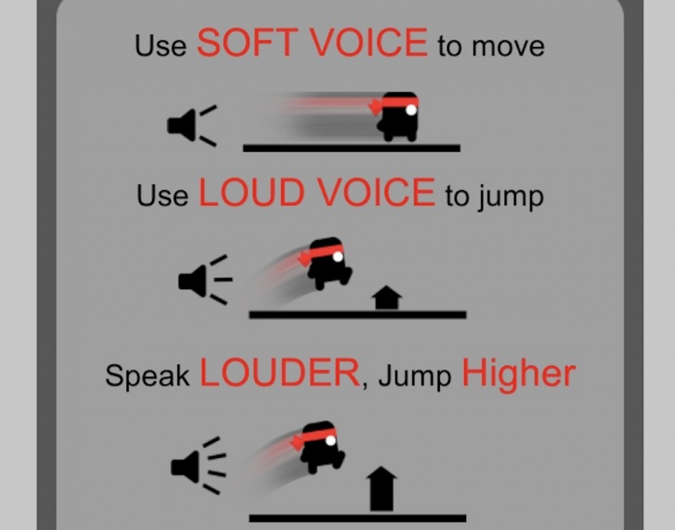
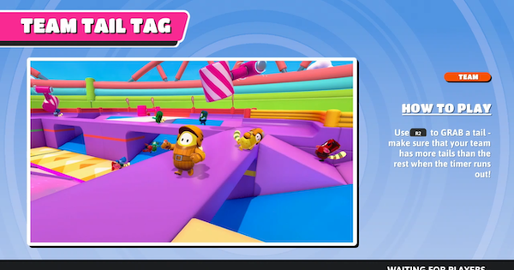
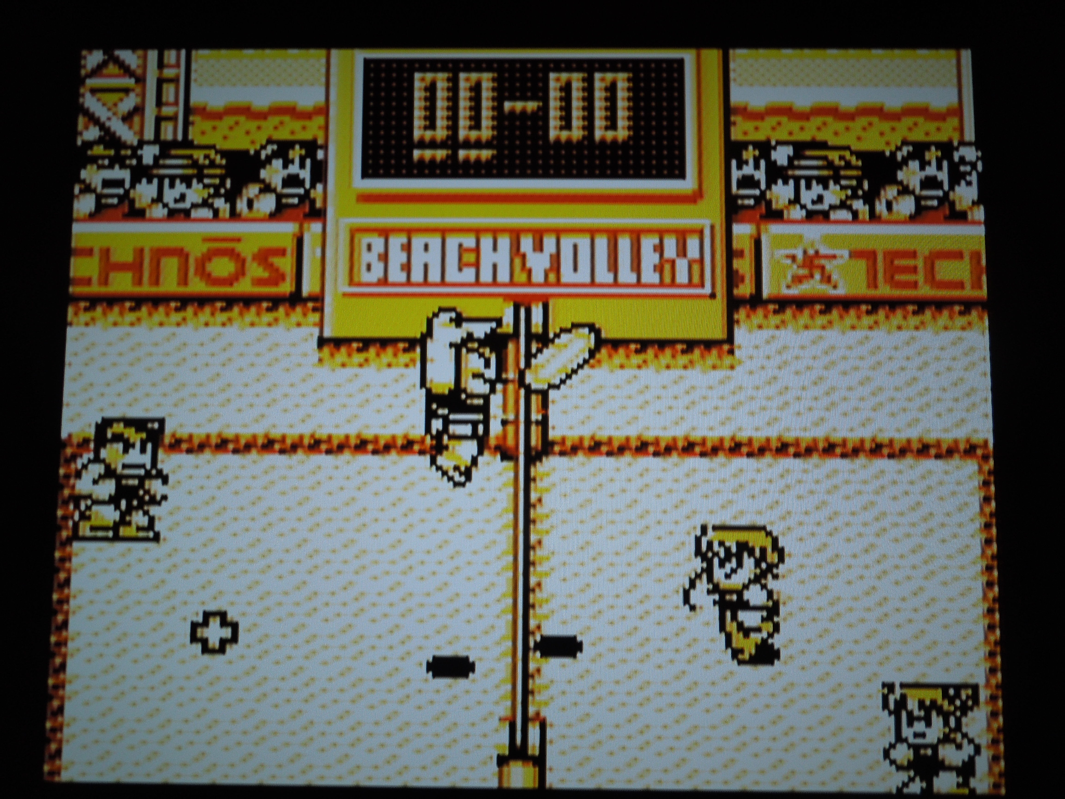
Reimagining Classic Game Archetypes into PVP
Jump King
Reveal the Maze
Scream Hero Go
Fall Guys
Neketsu Beach Volley

Slide 13
MINI-GAME OVERVIEW
1.Jump King
2. Blind Maze
3. Audio Obstacles
4.Reverse Tag
5.Volleyball
4 Players jumping upwards as the floor rises. Last one standing wins.
Blind ring of vision, explore mazes to reach the prized fish.
SCREAM, SCREAM, SCREAM TO JUMP. Don’t get knocked down!
One player holds the prized fish, hold onto it. When timer runs out, last one holding it wins.
Keep the ball in the air, the side that drops it loses.

Slide 14

PORO PARTY
Demo/Paper Prototype!

Slide 15
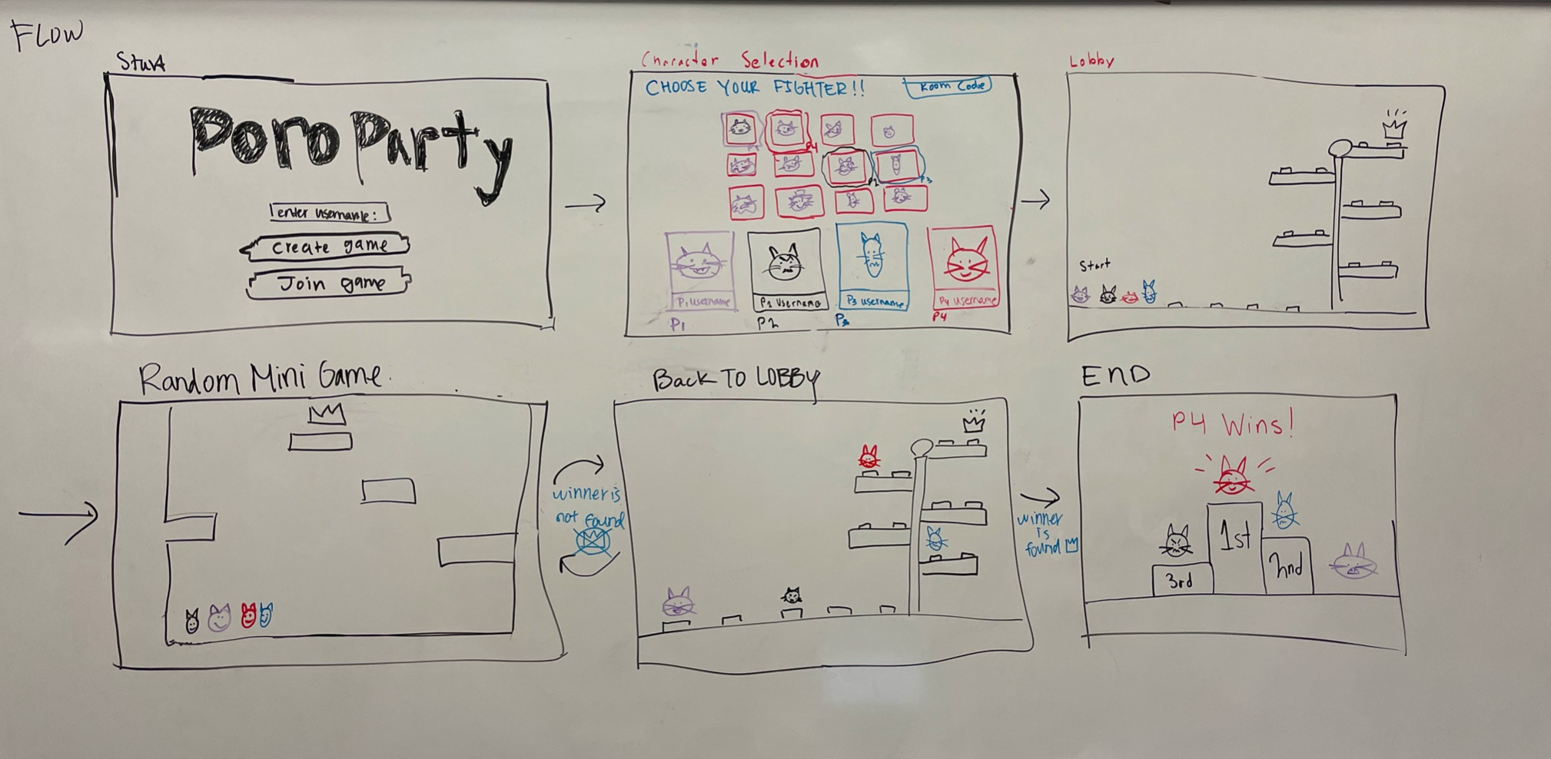
OVERVIEW OF GAME FLOW

Slide 16
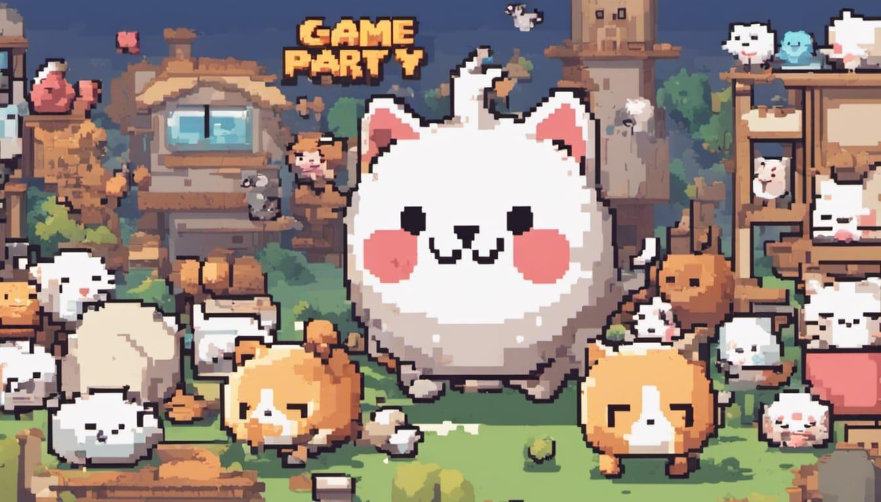
<START>
PORO
PARTY
Enter Username…
Create Game
Join Game

Slide 17
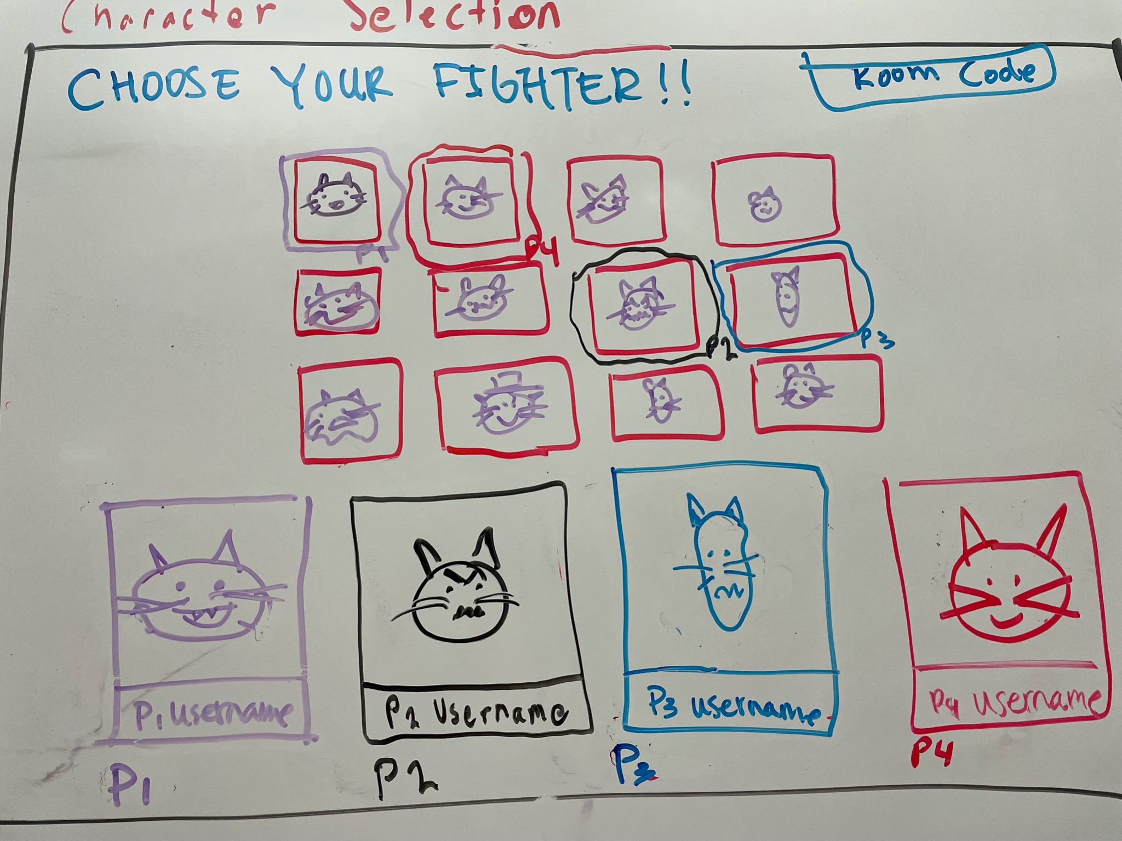
<CHARACTER SELECT>

Slide 18
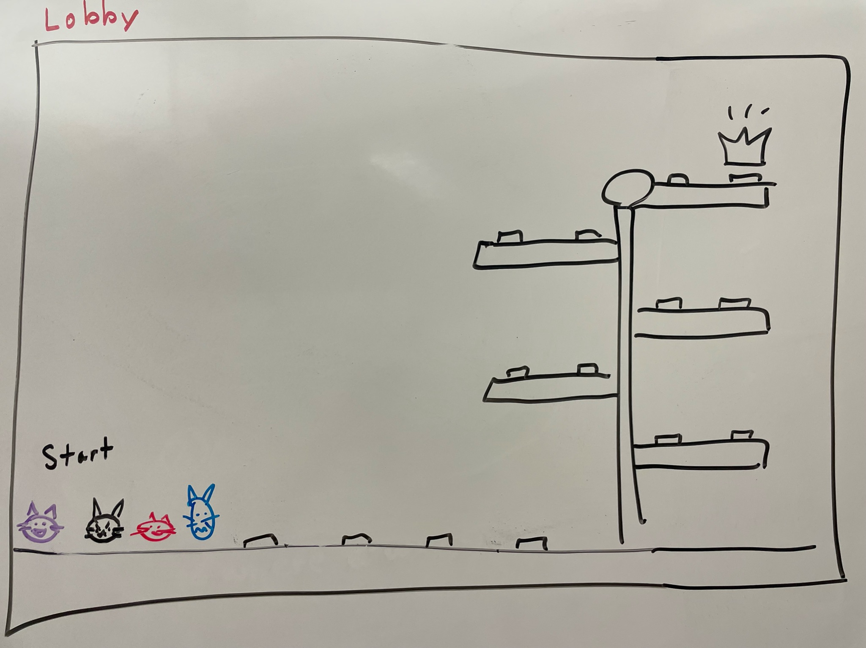
<LOBBY SCREEN>

Slide 19
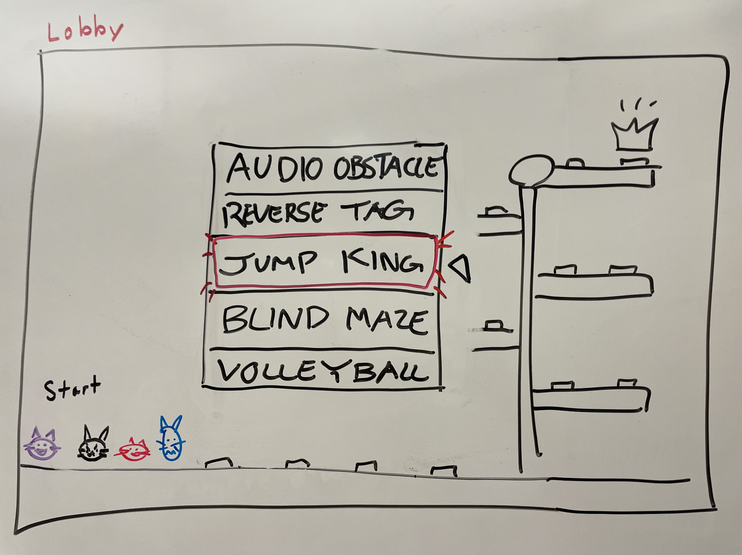
<RANDOM MINIGAME SELECTION>

Slide 20
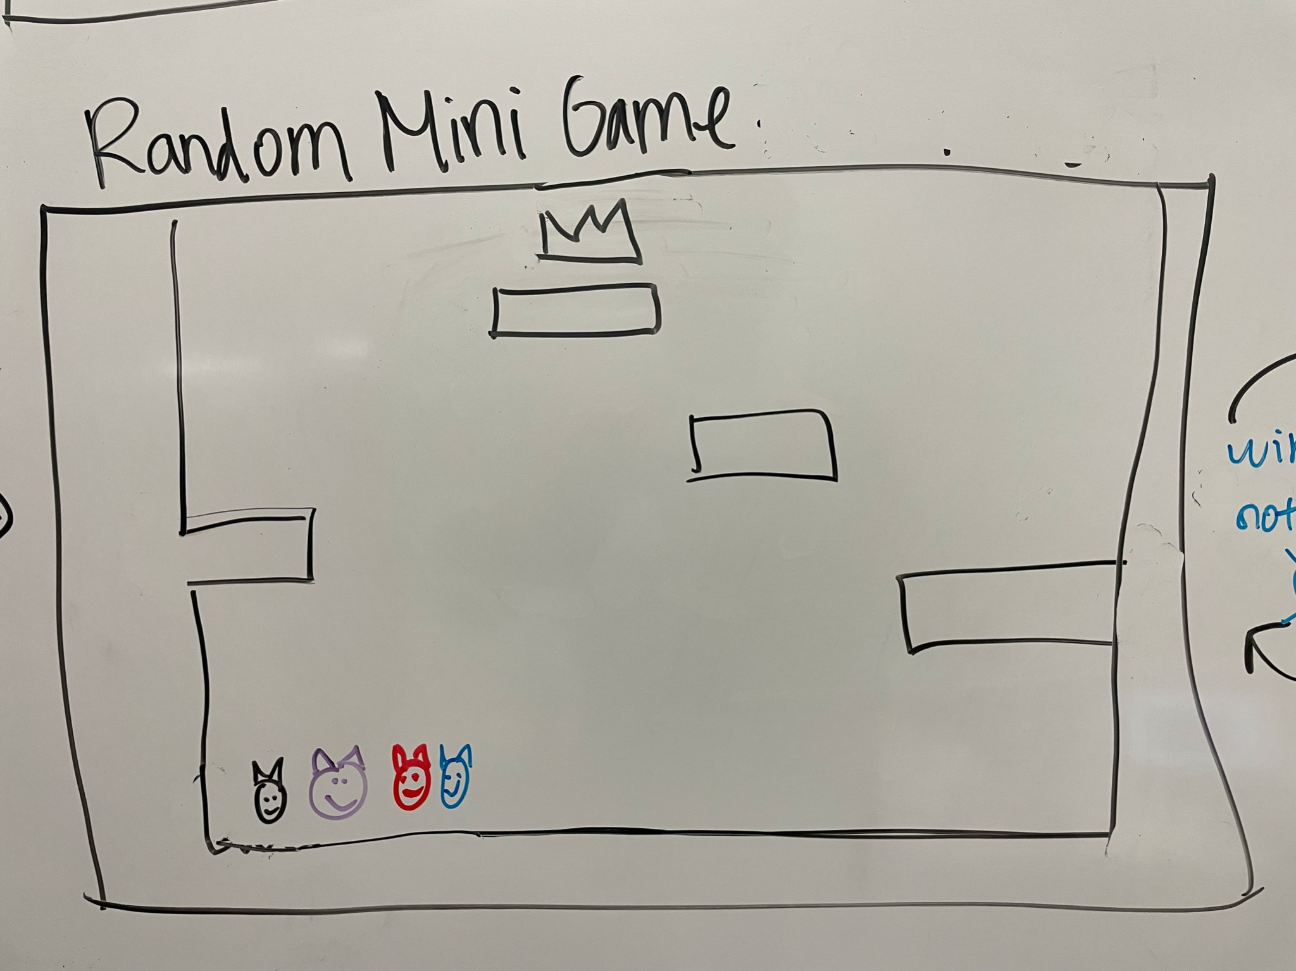
<MINIGAME>

Slide 21
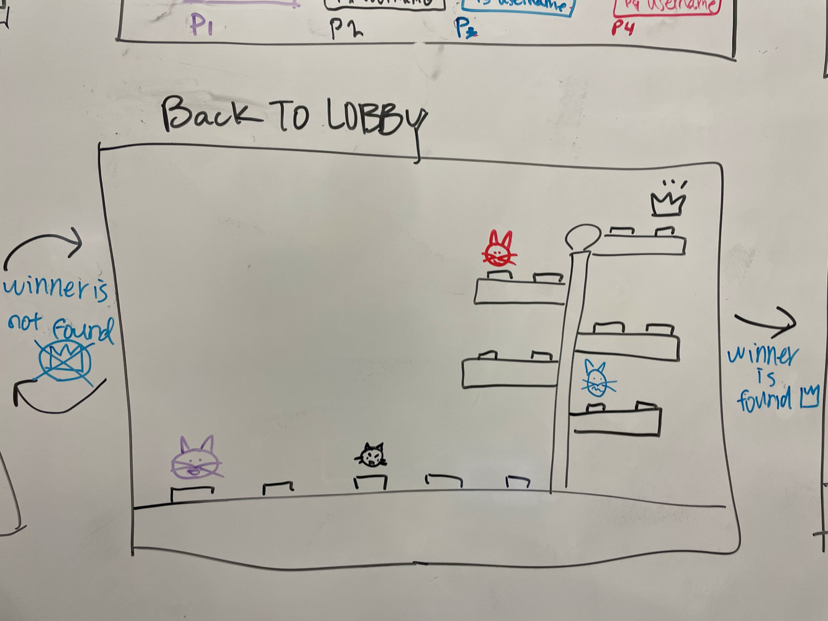
<LOBBY SCREEN>
Notes:
The higher the place, the more spaces and progress you will make in the overall game (lobby)

Slide 22
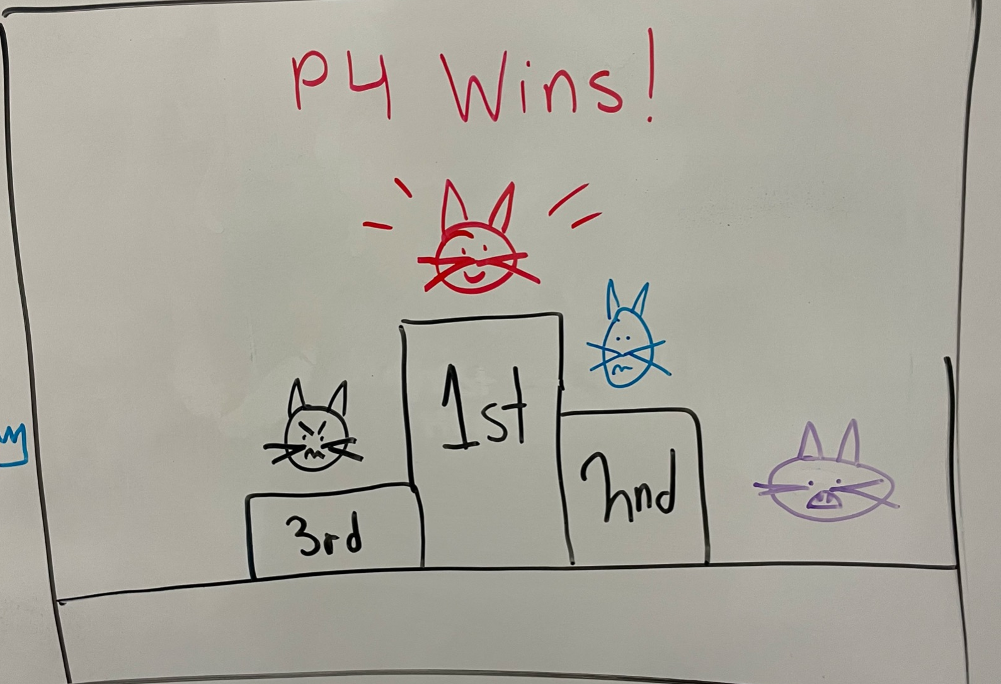
<END>

Slide 23

SUSTAINABILITY
TOOLS & RISKS

Slide 24
SUSTAINABILITY
Energy Efficiency and Optimization
Community Involvement
Health and Wellness
Longevity
Prevent digital download and physical production
Web based
Promoting social interaction, teamwork, and bonding among players
New to play with different people
Reduce environmental impact with new release
Engaging in a fun and lighthearted gaming experience provides players a mental break and reducing stress levels

Slide 25
TOOLS
Web Based
JavaScript natively runs in web browsers, so it is a natural fit for web-based games. It is also the language for Phaser.
Java Script
A popular 2D game engine that consists common features, including particle effects, model collision, animation, blend features, etc.
Phaser
2D Game

Slide 26
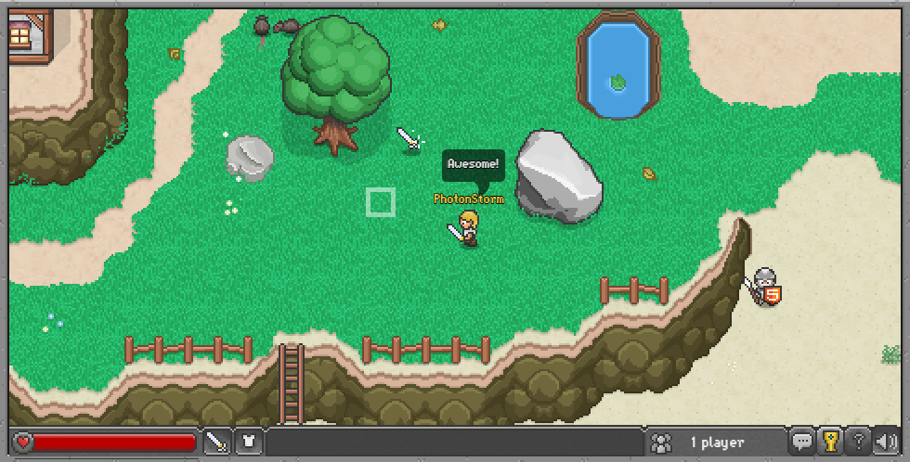
PHASER
Particle Effects
Collision Features
Character Animations
Customized Modules
Keyboard Controls

Slide 27
RISKS AND UNKNOWNS
1
Minigames
Incorporating multiple minigames into the overall game may be very challenging
Creating a smooth multiplayer experience over the web may be difficult to add
2
Multiplayer
No significant experience in programming games requires us to know exactly what we are trying to do and learn the best method to achieve it
3
Limited Knowledge
Notes:
Minigames, talk about changing the setting of the minigames, issues with storage, etc.
Multiplayer, limited knowledge about programming that requires constant communication between different local machines to the server

Slide 28

THANK YOU
FOR LISTENING!

